Slide 1

Tiny Circuit Hacks: Too Many LEDs!
Paul H. Dietz, PhD
Distinguished Engineer in Residence
Department of Computer Science
University of Toronto
October 2024

Slide 2

Prerequisites
Played with Arduino before
Made an LED blink on and off
An understanding of voltage and current
Slides are at: https://github.com/paulhdietz/TooManyLEDs

Slide 3
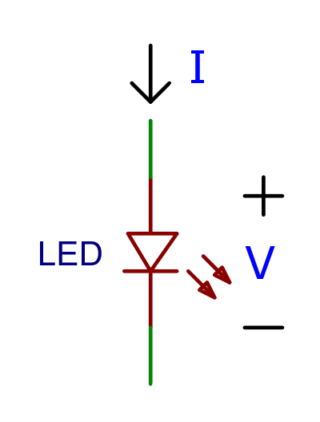


Ideal Diode Model
No current flows until voltage reaches $V_{f}$ (forward voltage)
Above $V_{f}$ , acts like a short so generally need some way to limit the current
I
$$V_{f}$$
V

Slide 4
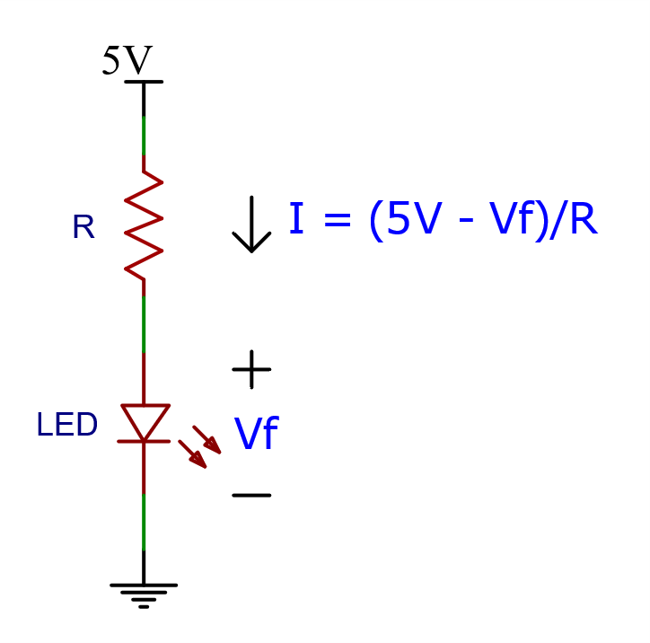

Powering an LED
Need to limit the current
Typically use a resistor
Example:
$V_{f}$=1.5V
R=220Ω
I = (5V-1.5V)/220Ω ≅ 15.9mA

Slide 5
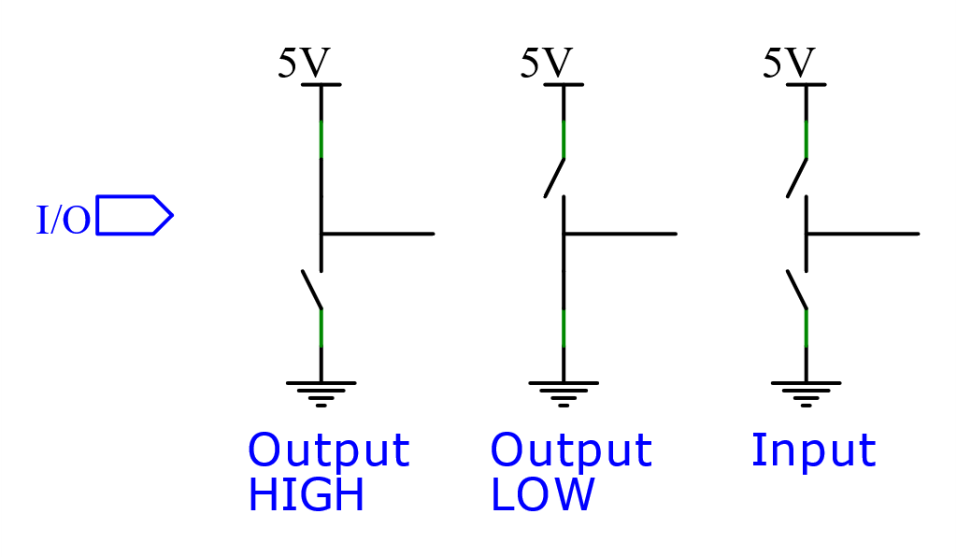
Digital I/O Pins Ideal Model

Slide 6
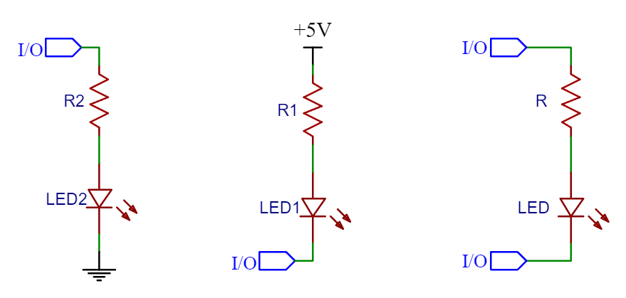
3 Ways of Controlling an LED From A Micro

Slide 7
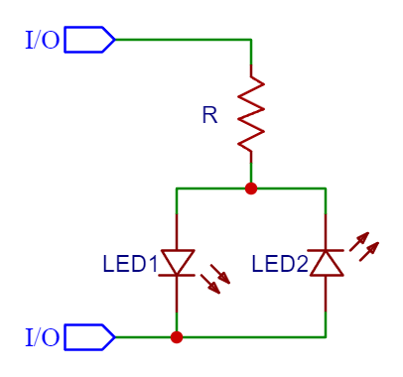
2 LEDs, 2 Pins
An LED only lets current flow one direction
Flip high and low to change which LED lights
Fundamental Limitation: can only light one LED at a time!
Flicker fusion occurs around 50Hz
Fastly switching among LEDs makes it look like they are on simultaneously
Solution: Multiplexing (Scanning)
Can only be half as bright
Increase current to compensate?

Slide 8
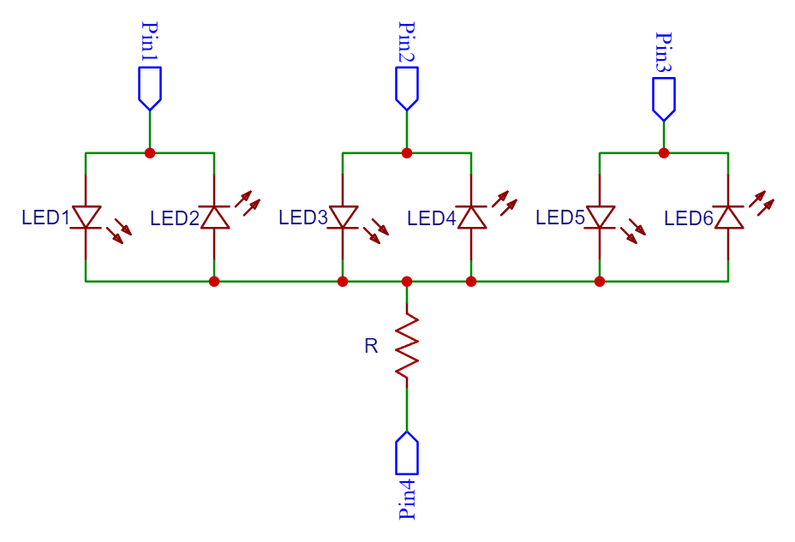
Bidirectional LEDs on Each Pin
Two LEDs for each additional pin
Unused Pins are set to Input - Disconnected
This is starting to be a significant win
n Pins, 2(n-1) LEDs

Slide 9
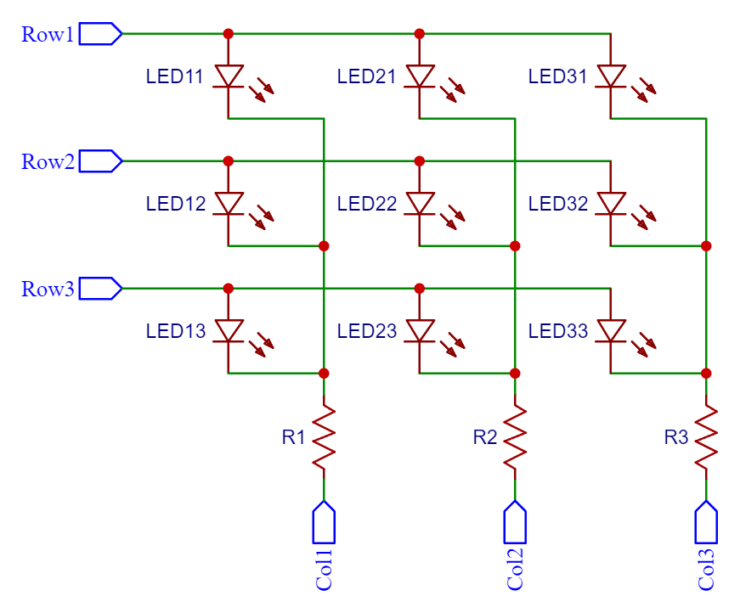
Row-Column
X+Y Pins, X*Y LEDs
An entire row can be controlled simultaneously
Often used for driving 7-segment displays where digits are driven one at a time

Slide 10
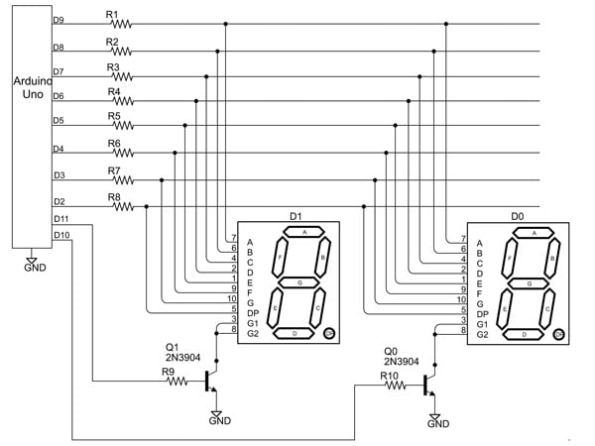
Seven Segment Display
“Seven” segment displays can be common anode or common cathode
Digit drive needs to handle more current, so an external transistor is often utilized
Source: https://www.jameco.com/Jameco/workshop/TechTip/working-with-seven-segment-displays.html

Slide 11
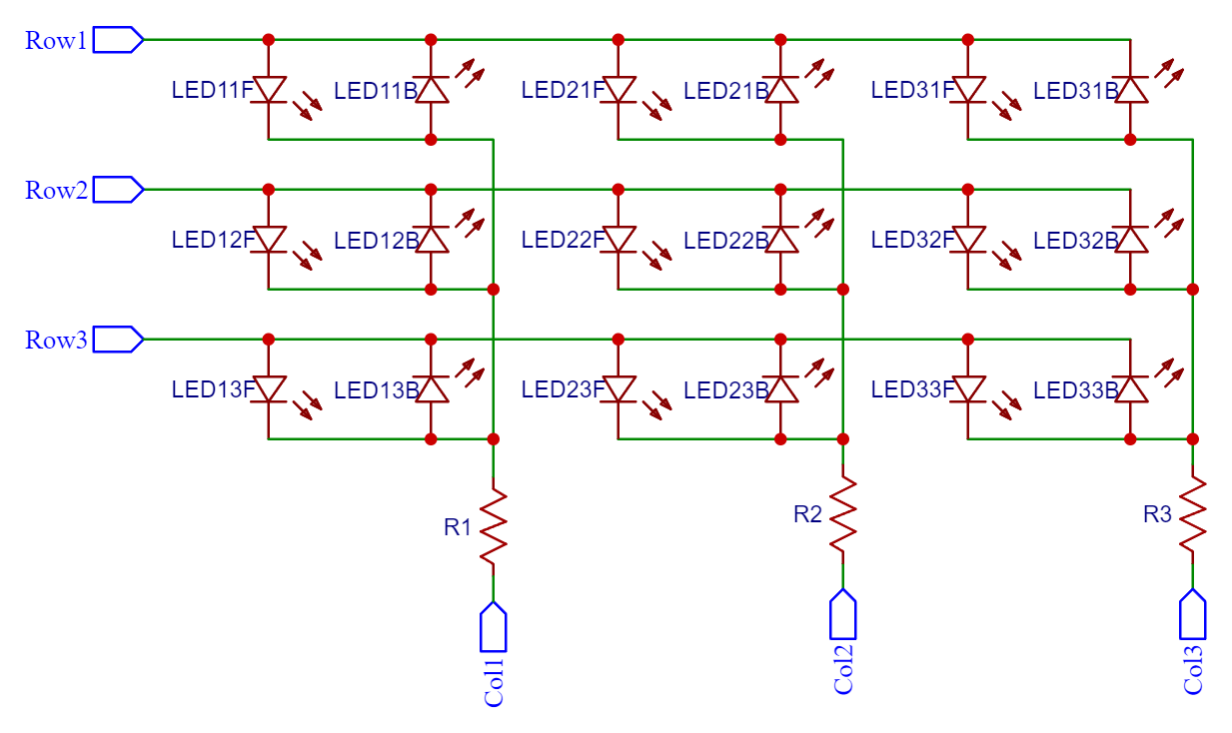
Bidirectional Row-Column
X+Y Pins, 2*X*Y LEDs
Basically, a matrix form of the bidirectional drive
Can’t address a row at a time – single LED mutliplexing

Slide 12
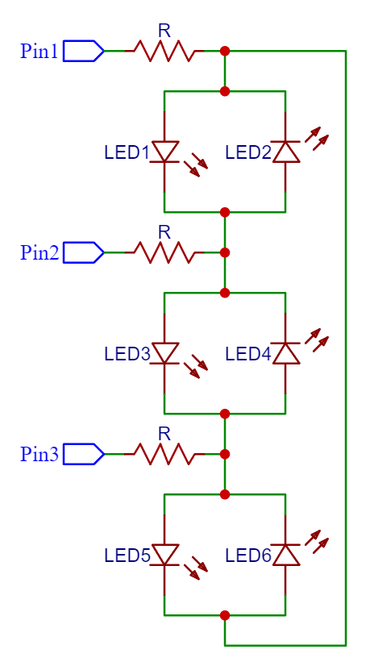
Bidirectional Between EVERY Pair: Charlieplexing
n Pins, n² - n pairs of Pins
To drive, turn one pin high, one low, other Input
Note path is through 2R

Slide 13
Another Loop?
There is a parasitic path through other LEDs, but with two LEDs in series
It will not turn on unless the forward voltage of drop of those two LEDs is less than the forward voltage drop of the desired LED

Slide 14
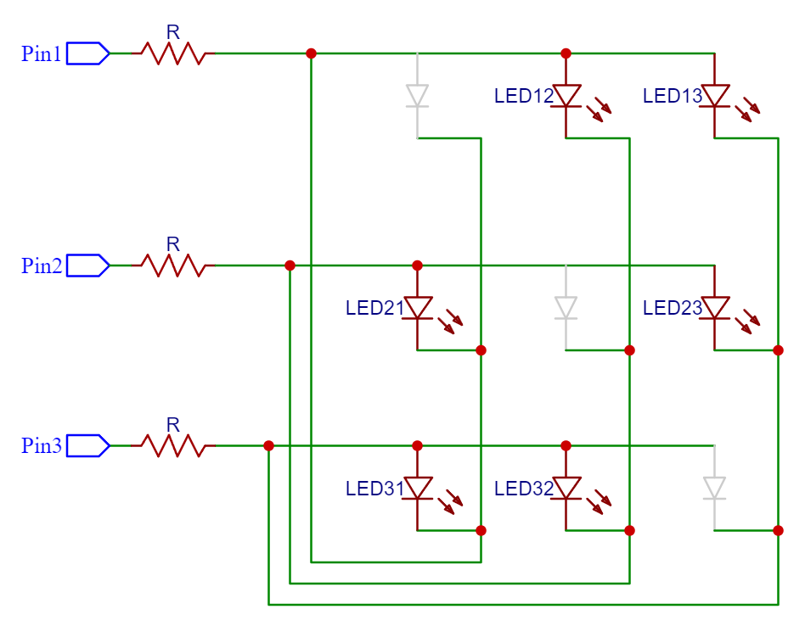
Charlieplexing Matrix
A matrix with the same wires on for the rows and columns, missing the diagonal

Slide 15
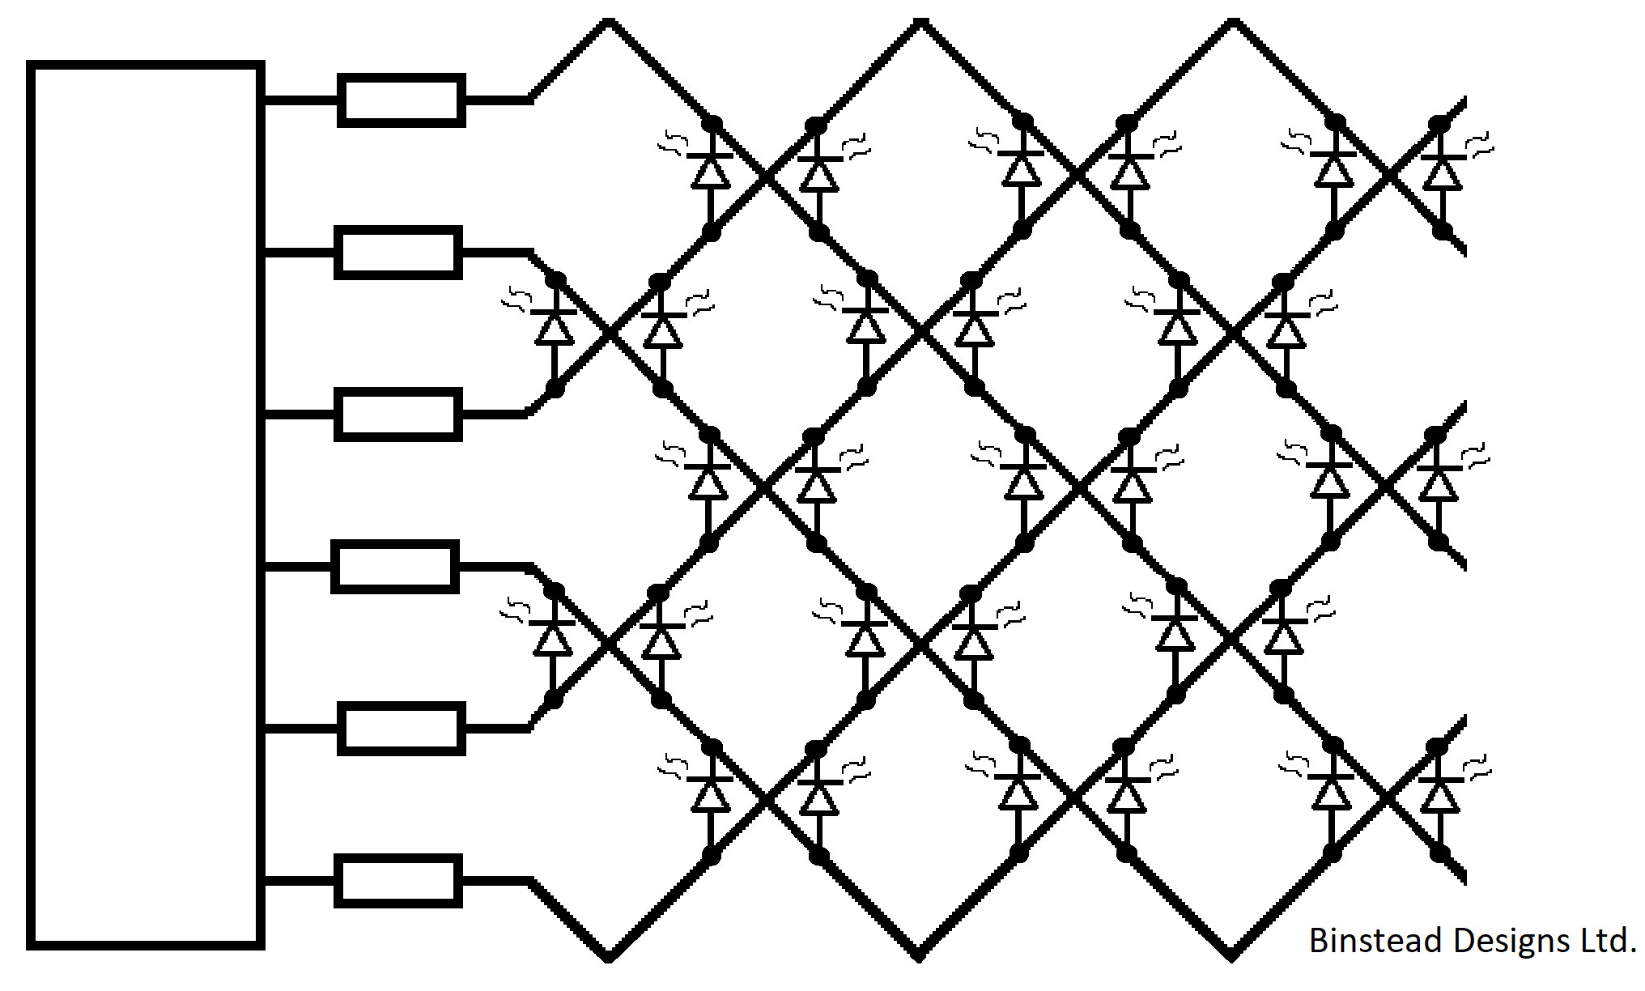
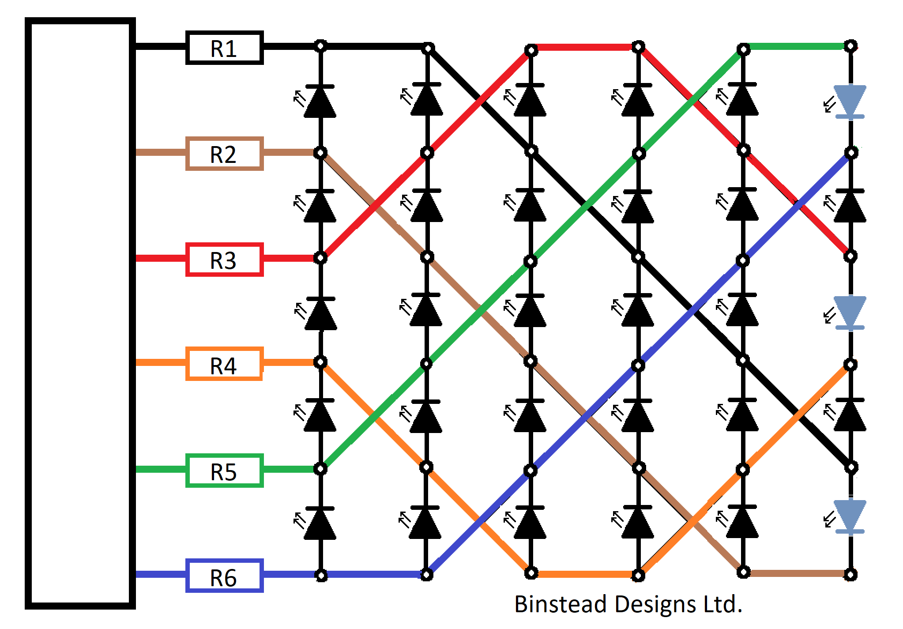
Charlieplexing Layouts
Source: https://en.wikipedia.org/wiki/Charlieplexing

Slide 17
Can YOU Do Better?
Theoretically, YES
If each pin has 3 states (HIGH, LOW, INPUT) you should theoretically be able to address 3^{n} – 1 LEDs with n pins
Practically, YES
You can add extra electronics so you can send a sequence of data to control large numbers of LEDs

Slide 18
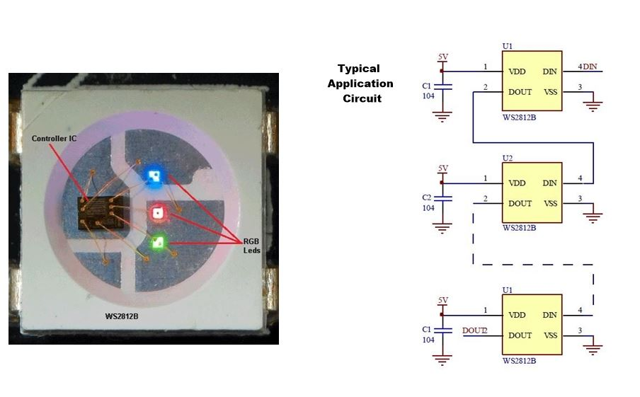
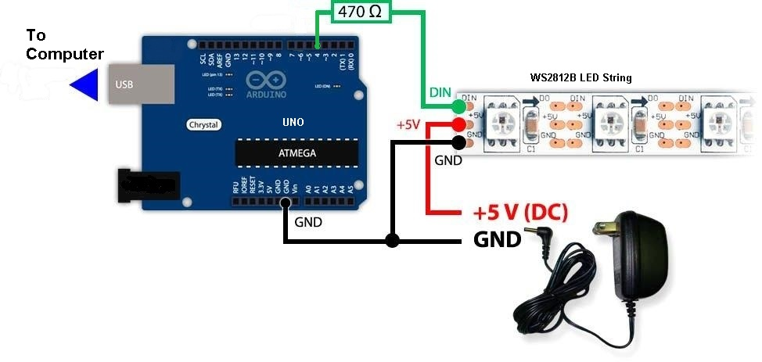
LEDs with Built-In Controllers
Different color LEDs in single package with a controller (e.g. WS2812B, AdaFruit NeoPixel, etc.)
Simple serial data protocol, designed to be daisy chained
Source: https://amptech.co.nz/WS2812B-LED-String-with-Arduino

Slide 19
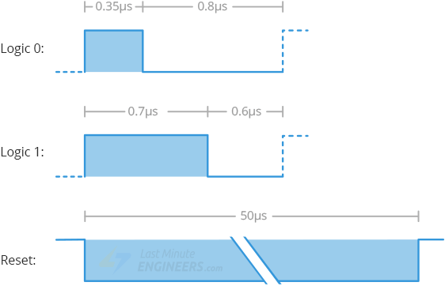
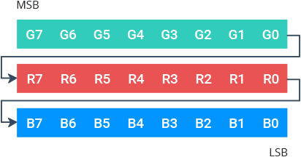
Data Protocol
Specifics depend on controller chip
Controller grabs the first hunk of data to control its LEDs, and passes on the rest
LEDs are effectively “addressed” by how far they are from the first
Unusual “0” and “1” timing
Not straightforward to use standard communications peripherals
Bit rate often in excess of 1Mbps
Requires low level bit banging, with precise timing
Libraries typically hand-written in assembly
Source: https://lastminuteengineers.com/ws2812b-arduino-tutorial/

Slide 20
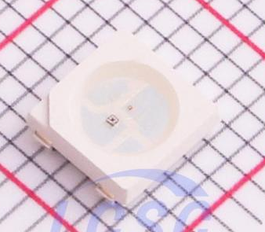
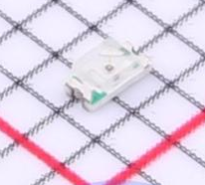
Cost Comparison
As of October 6, 2024, JLCPCB Parts Library
RGB with controller: Xinglight XL-5050RGBC-WS2812B-S
Quantity 1: US$0.0262 each
Quantity 5000: US$0.0158 each
Basic red LED: Yongyu Photoelectric SZYY0603R1
Quantity 1: US$0.0027 each
Quantity 4000: US$0.0023 each
Source: JLCPCB

Slide 21
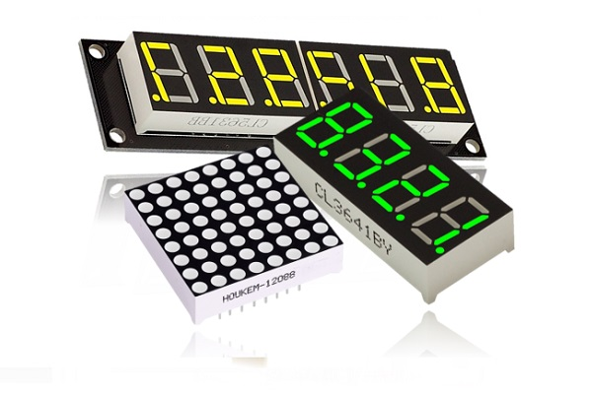
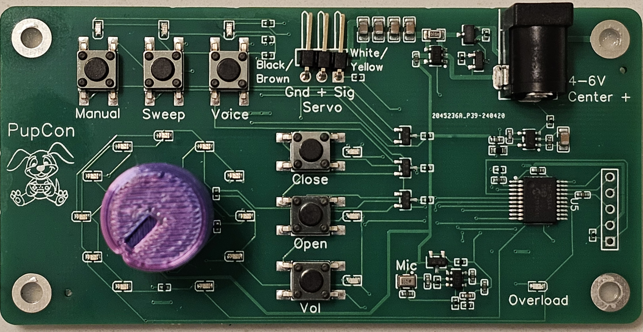
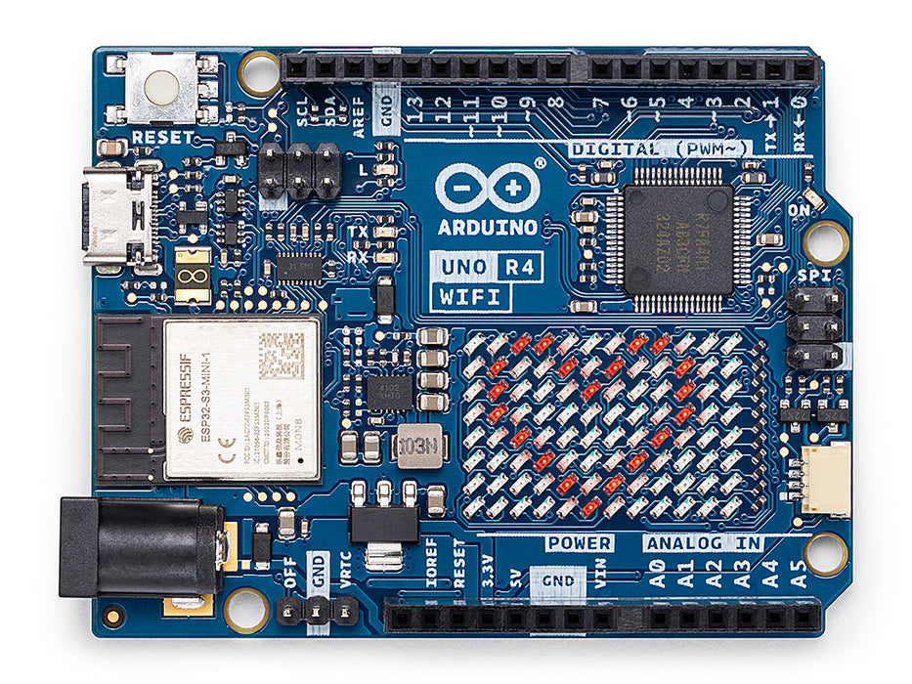
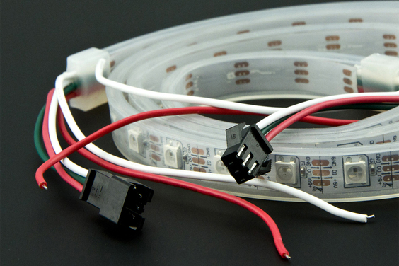
Which to Use?
A couple of LEDs
Wire directly to pins
A multi-digit 7-segment display, CC or CA
Row-column with scanned digits
Show state where one of many LEDs is on
Charlieplexing is ideal because allows full brightness on single LED
Cheap, little display (e.g. Arduino UNO R4 WiFi)
Charlieplexing lots of discrete LEDs is cheap
A long, colorful, light strip for room lighting
RGB LEDs with built-in controllers, e.g. WS2812B
Sources: https://www.first-components.com/it/display-solutions-led-display, https://store-usa.arduino.cc/products/uno-r4-wifi, https://www.dfrobot.com/product-1113.html

